Slide 1
Current sensor interfacing

Slide 2
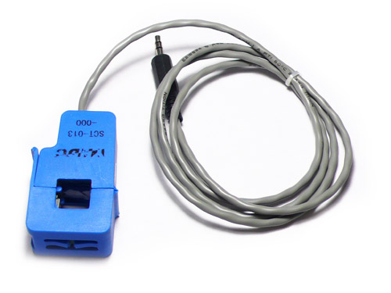
Current sensor SCT-013-000 can be interfaced with Arduino
In the case of whole building monitoring, the primary is the live (or) the neutral wire (not both!) coming into the building itself, and is passed through the hole in the CT. The secondary winding is made of many turns of fine wire housed within the transformer casing

Slide 3

Current sensor
The sensor can
be clamped onto the mains lines without
interrupting power into the circuit breaker
The output of the current transducer is an AC voltage proportional to the AC current enclosed by the sensor’s ring

Slide 4
Installation of current sensor
One sensor is clamped onto each “hot” wire going
into the circuit breaker. The total current being drawn by the household is the sum of the measured current in both wires.
So now current is measured :D !

Slide 5
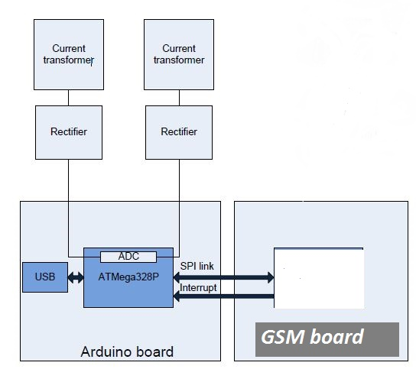
Interfacing with arduino

Slide 6
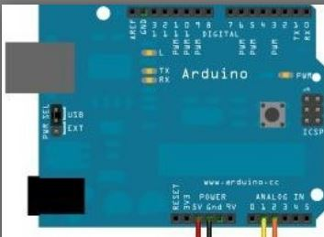
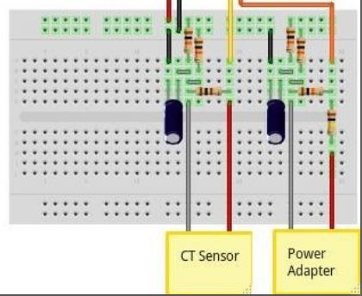

Slide 7
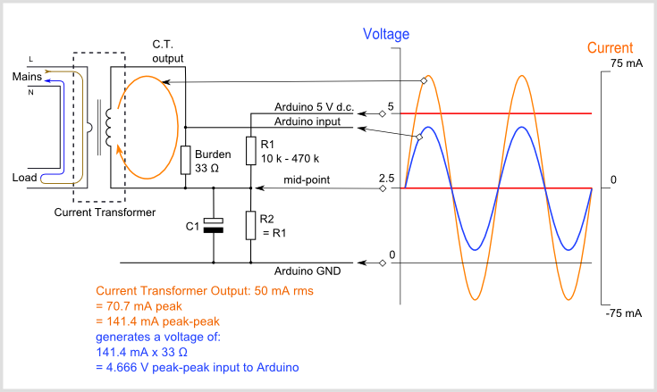
Circuit diagram

